Slide 1
Suffix tries, trees and arrays
CMSC420 0101
Spring 2019

Slide 2
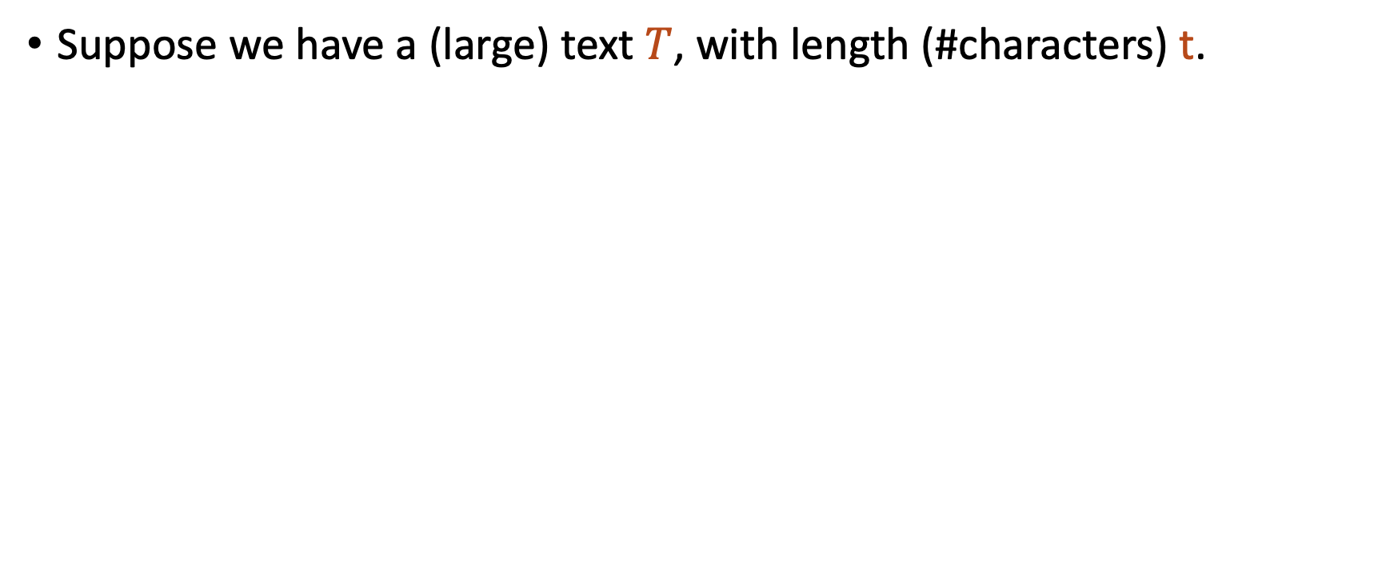
String matching problem
Suppose we have a (large) text $T$, with length (#characters) t.

Slide 3
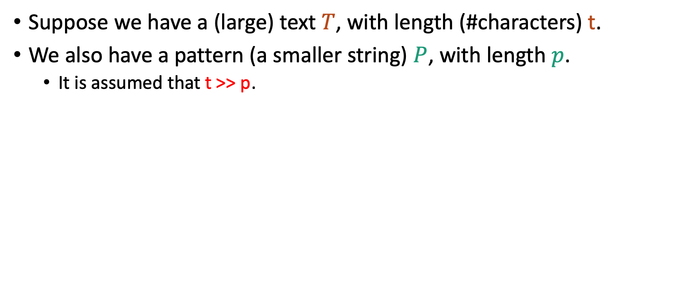
String matching problem
Suppose we have a (large) text $T$, with length (#characters) t.
We also have a pattern (a smaller string) $P$, with length $p$.
It is assumed that t >> p.

Slide 4
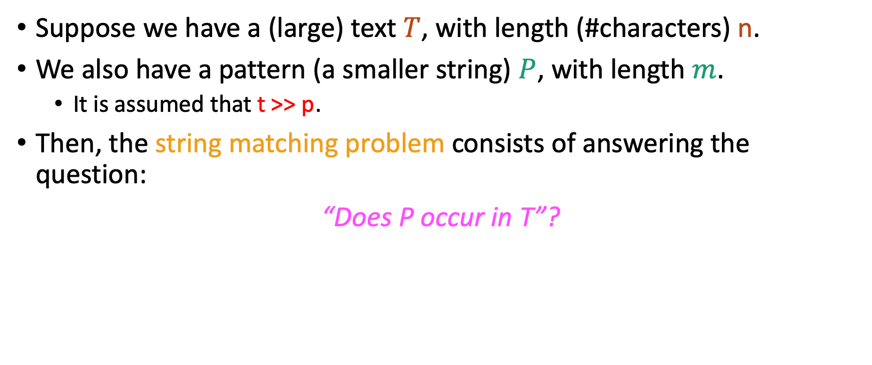
String matching problem
Suppose we have a (large) text $T$, with length (#characters) n.
We also have a pattern (a smaller string) $P$, with length $m$.
It is assumed that t >> p.
Then, the string matching problem consists of answering the question:
“Does P occur in T”?

Slide 5
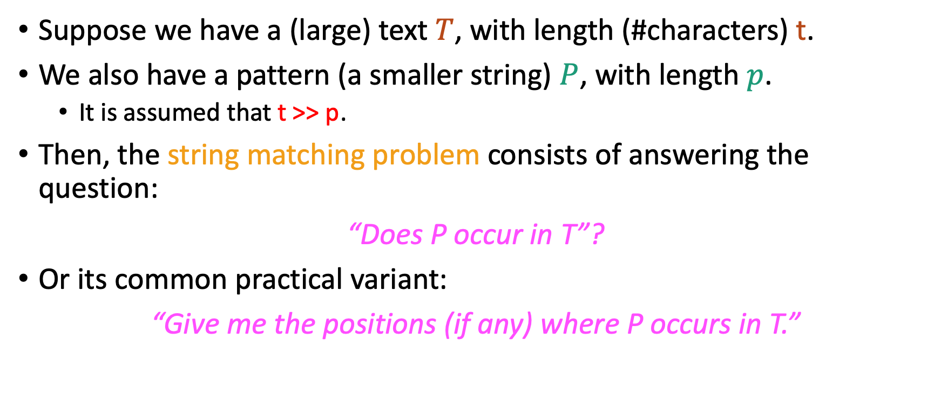
String matching problem
Suppose we have a (large) text $T$, with length (#characters) t.
We also have a pattern (a smaller string) $P$, with length $p$.
It is assumed that t >> p.
Then, the string matching problem consists of answering the question:
“Does P occur in T”?
Or its common practical variant:
“Give me the positions (if any) where P occurs in T.”

Slide 6
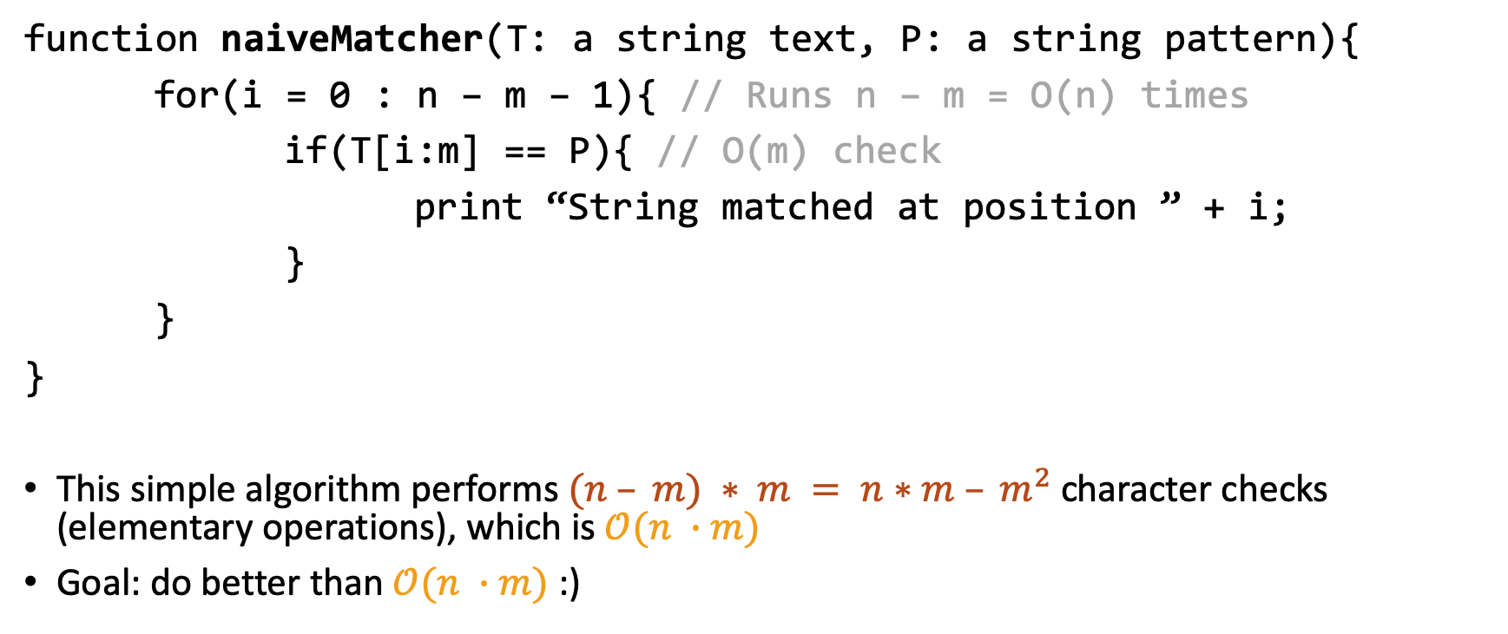
Naïve approach
function naiveMatcher(T: a string text, P: a string pattern){
for(i = 0 : n – m – 1){ // Runs n – m = O(n) times
if(T[i:m] == P){ // O(m) check
print “String matched at position ” + i;
}
}
}
This simple algorithm performs $(n – m) ∗ m = n∗m – m^{2}$ character checks (elementary operations), which is $𝒪(n ∙m)$
Goal: do better than $𝒪(n ∙m)$ :)

Slide 7
Types of string matching algorithms
Ones that pre-process the pattern
Knuth-Morris Pratt (KMP)
Boyer-Moore
Ones that pre-process the text
Rabin-Karp
Suffix tries / trees
Suffix arrays
Extended suffix arrays, LCP arrays…

Slide 8
Part 1: Pre-processing the pattern with KMP

Slide 9
KMP
We will first discuss KMP as an example of an algorithm of type 1.

Slide 10
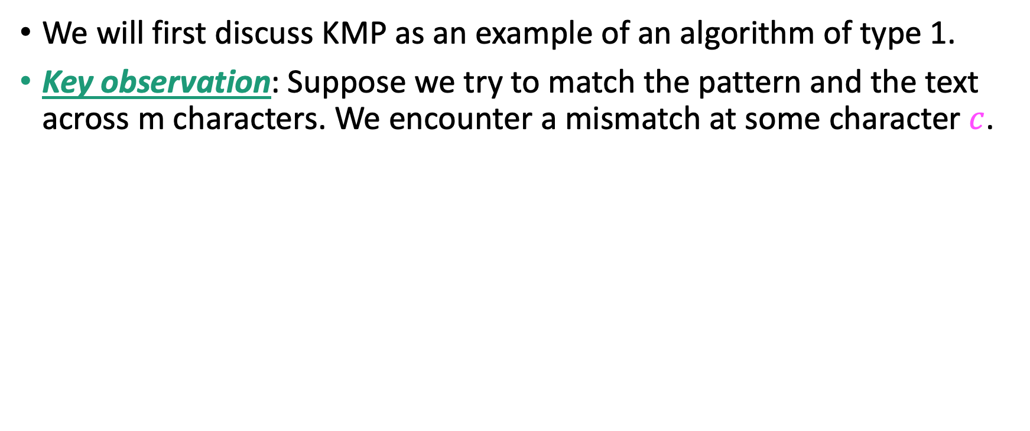
KMP
We will first discuss KMP as an example of an algorithm of type 1.
Key observation: Suppose we try to match the pattern and the text across m characters. We encounter a mismatch at some character $c$.

Slide 11
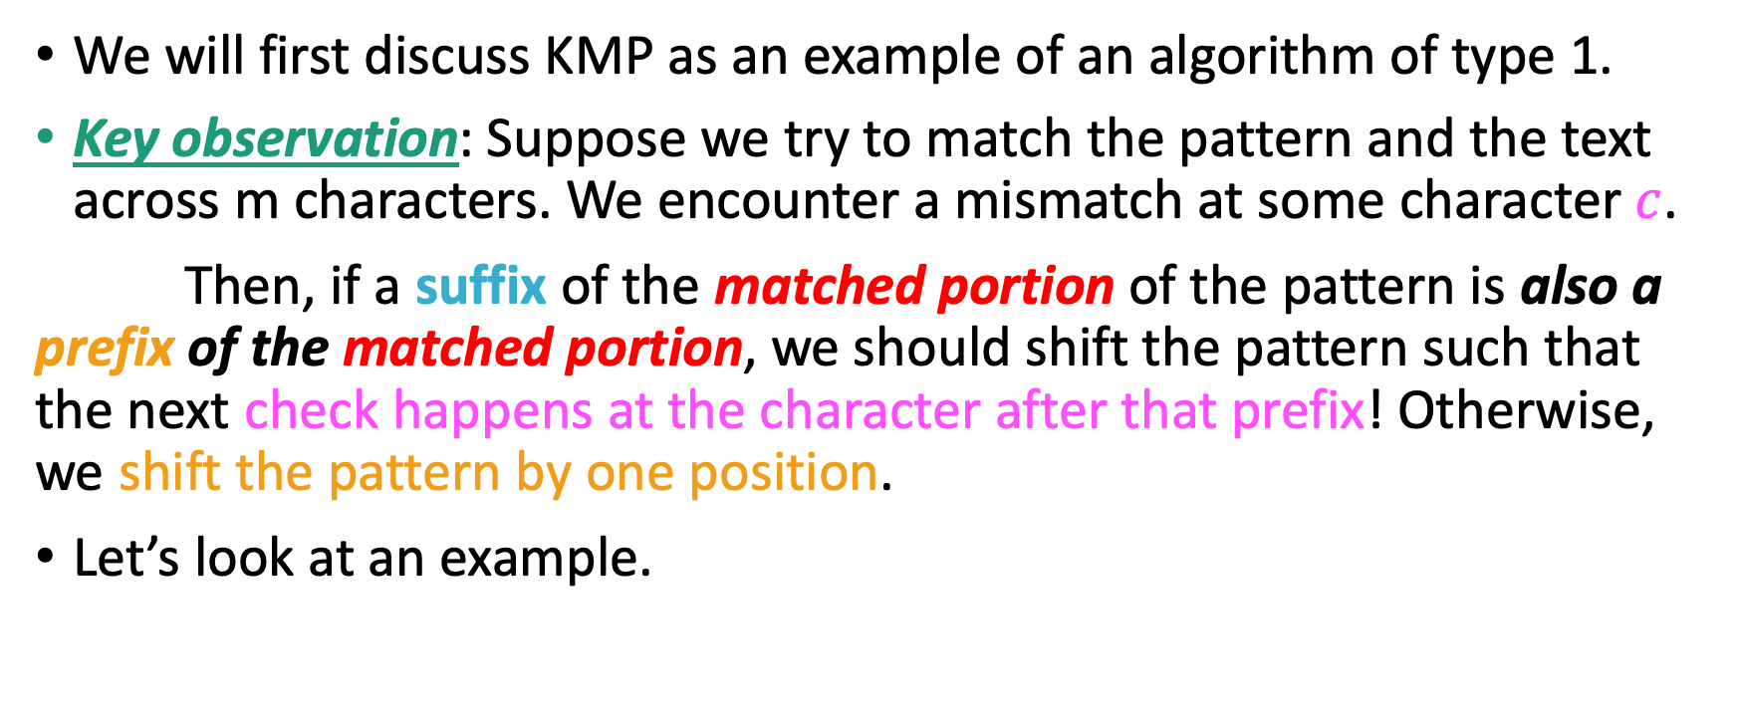
KMP
We will first discuss KMP as an example of an algorithm of type 1.
Key observation: Suppose we try to match the pattern and the text across m characters. We encounter a mismatch at some character $c$.
Then, if a suffix of the matched portion of the pattern is also a prefix of the matched portion, we should shift the pattern such that the next check happens at the character after that prefix! Otherwise, we shift the pattern by one position.
Let’s look at an example.

Slide 12
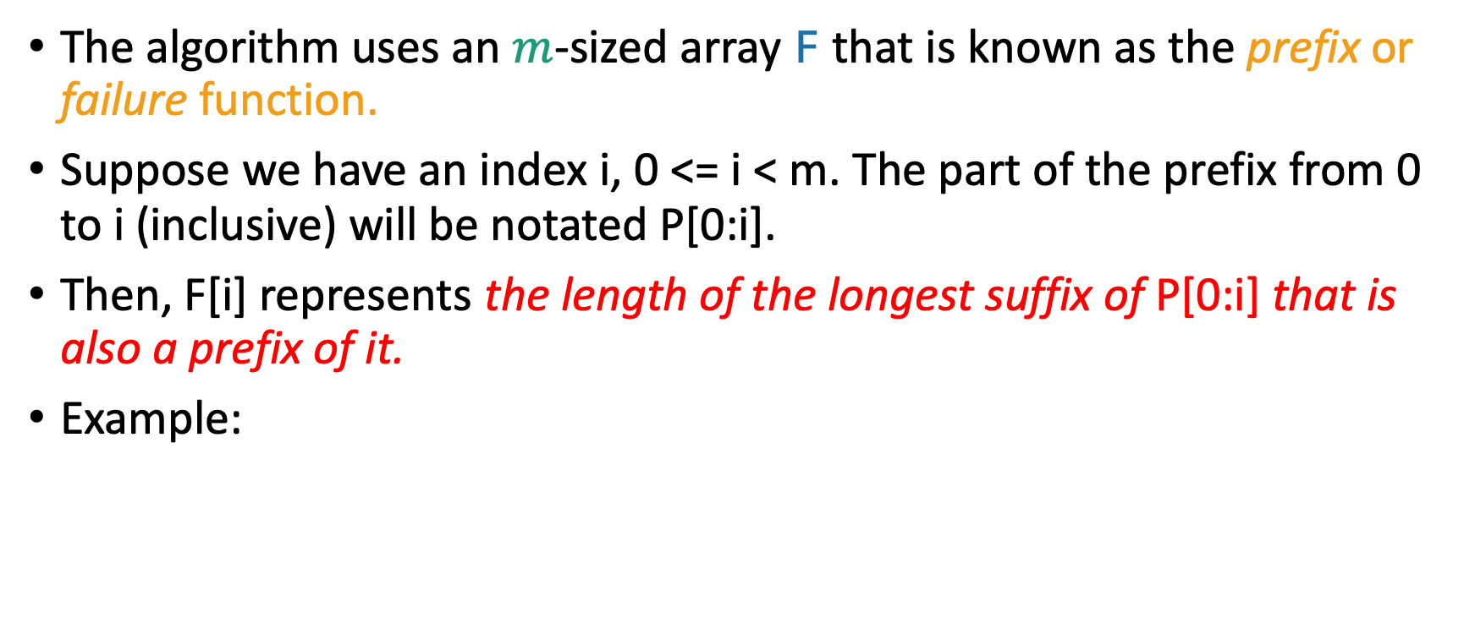
So, how do we do this?
The algorithm uses an $m$-sized array F that is known as the prefix or failure function.
Suppose we have an index i, 0 <= i < m. The part of the prefix from 0 to i (inclusive) will be notated P[0:i].
Then, F[i] represents the length of the longest suffix of P[0:i] that is also a prefix of it.
Example:
 | 0 | 1 | 2 | 3 | 4 | 5 | 6
P | e | t | e | t | e | s | e
F | 0 | 0 | 1 | 2 | 3 | 0 | 1

Slide 13
Exercise!
Compute the prefix function for the following pattern:
 | 0 | 1 | 2 | 3 | 4 | 5 | 6 | 7 | 8 | 9 | 10 | 11 | 12 | 13
P | x | x | a | x | b | x | x | b | a | x | x | a | x | b
F

Slide 14
Exercise!
Compute the prefix function for the following pattern:
 | 0 | 1 | 2 | 3 | 4 | 5 | 6 | 7 | 8 | 9 | 10 | 11 | 12 | 13
P | x | x | a | x | b | x | x | b | a | x | x | a | x | b
F | 0 | 1 | 0 | 1 | 0 | 1 | 2 | 0 | 0 | 1 | 2 | 3 | 4 | 5

Slide 15

Exercise!
Compute the prefix function for the following pattern:
And this one!
 | 0 | 1 | 2 | 3 | 4 | 5 | 6 | 7 | 8 | 9 | 10 | 11 | 12 | 13
P | x | x | a | x | b | x | x | b | a | x | x | a | x | b
F | 0 | 1 | 0 | 1 | 0 | 1 | 2 | 0 | 0 | 1 | 2 | 3 | 4 | 5
 | 0 | 1 | 2 | 3 | 4 | 5 | 6 | 7 | 8 | 9 | 10 | 11 | 12 | 13
P | x | x | x | x | x | x | x | x | x | x | x | x | x | a
F

Slide 16
Exercise!
Compute the prefix function for the following pattern:
And this one!
 | 0 | 1 | 2 | 3 | 4 | 5 | 6 | 7 | 8 | 9 | 10 | 11 | 12 | 13
P | x | x | a | x | b | x | x | b | a | x | x | a | x | b
F | 0 | 1 | 0 | 1 | 0 | 1 | 2 | 0 | 0 | 1 | 2 | 3 | 4 | 5
 | 0 | 1 | 2 | 3 | 4 | 5 | 6 | 7 | 8 | 9 | 10 | 11 | 12 | 13
P | x | x | x | x | x | x | x | x | x | x | x | x | x | a
F | 0 | 1 | 2 | 3 | 4 | 5 | 6 | 7 | 8 | 9 | 10 | 11 | 12 | 0

Slide 17

Exercise!
Compute the prefix function for the following pattern:
And this one!
And this one!
 | 0 | 1 | 2 | 3 | 4 | 5 | 6 | 7 | 8 | 9 | 10 | 11 | 12 | 13
P | x | x | a | x | b | x | x | b | a | x | x | a | x | b
F | 0 | 1 | 0 | 1 | 0 | 1 | 2 | 0 | 0 | 1 | 2 | 3 | 4 | 5
 | 0 | 1 | 2 | 3 | 4 | 5 | 6 | 7 | 8 | 9 | 10 | 11 | 12 | 13
P | x | x | x | x | x | x | x | x | x | x | x | x | x | a
F | 0 | 1 | 2 | 3 | 4 | 5 | 6 | 7 | 8 | 9 | 10 | 11 | 12 | 0
 | 0 | 1 | 2 | 3 | 4 | 5 | 6 | 7 | 8 | 9 | 10 | 11 | 12 | 13
P | a | x | x | x | x | x | x | x | x | x | x | x | x | x
F

Slide 18

Exercise!
Compute the prefix function for the following pattern:
And this one!
And this one!
 | 0 | 1 | 2 | 3 | 4 | 5 | 6 | 7 | 8 | 9 | 10 | 11 | 12 | 13
P | x | x | a | x | b | x | x | b | a | x | x | a | x | b
F | 0 | 1 | 0 | 1 | 0 | 1 | 2 | 0 | 0 | 1 | 2 | 3 | 4 | 5
 | 0 | 1 | 2 | 3 | 4 | 5 | 6 | 7 | 8 | 9 | 10 | 11 | 12 | 13
P | x | x | x | x | x | x | x | x | x | x | x | x | x | a
F | 0 | 1 | 2 | 3 | 4 | 5 | 6 | 7 | 8 | 9 | 10 | 11 | 12 | 0
 | 0 | 1 | 2 | 3 | 4 | 5 | 6 | 7 | 8 | 9 | 10 | 11 | 12 | 13
P | a | x | x | x | x | x | x | x | x | x | x | x | x | x
F | 0 | 0 | 0 | 0 | 0 | 0 | 0 | 0 | 0 | 0 | 0 | 0 | 0 | 0

Slide 19
Pseudocode for building F
Compute-Prefix-Function(p: String pattern){
m = |p|;
F = array[m];
F[0] = 0;
k = 0;
for(q=1:m-1){
while((k > 0) && (p[k] != p[q]) ){ // As long as you can’t match….
k = F[k-1]; // Keep backtracking to find other potential prefixes that are also suffixes.
}
if(p[k] == p[q]){
k++; // Length of current matched prefix increased.
}
F[q] = k; // Set the current value to the length of the maximal prefix that is also a suffix.
}
return F;
}

Slide 20
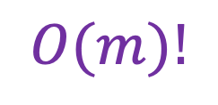
Pseudocode for building F
Compute-Prefix-Function(p: String pattern){
m = |p|;
F = array[m];
F[0] = 0;
k = 0;
for(q=1:m-1){
while((k > 0) && (p[k] != p[q]) ){ // As long as you can’t match….
k = F[k-1]; // Keep backtracking to find other potential prefixes that are also suffixes.
}
if(p[k] == p[q]){
k++; // Length of current matched prefix increased.
}
F[q] = k; // Set the current value to the length of the maximal prefix that is also a suffix.
}
return F;
}
$$O(m)!$$

Slide 21
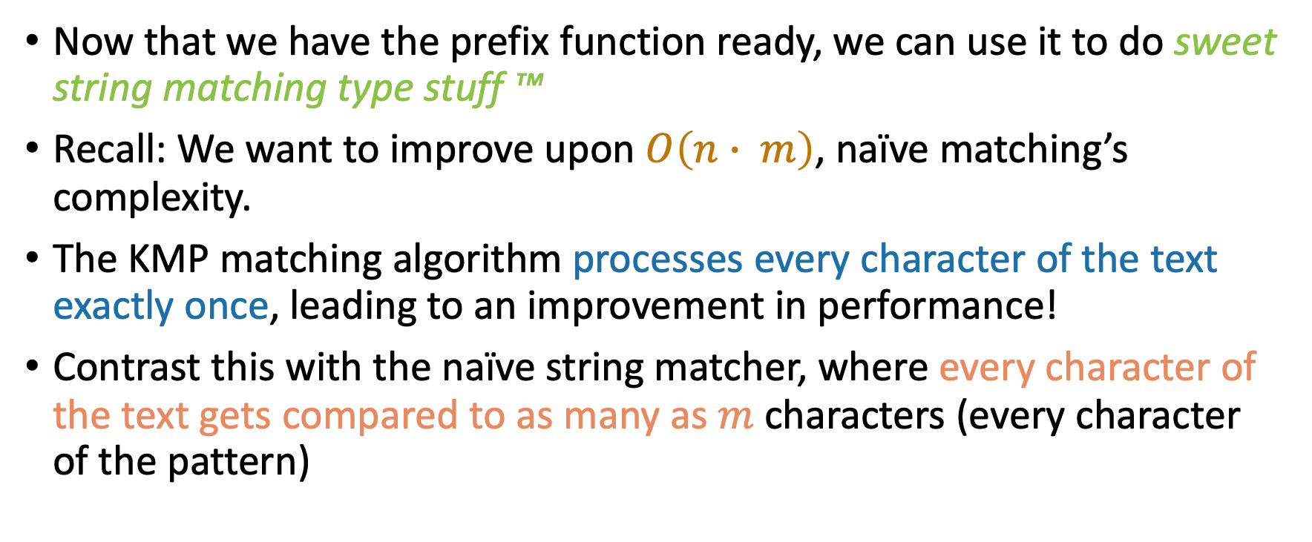
Using the prefix function
Now that we have the prefix function ready, we can use it to do sweet string matching type stuff ™
Recall: We want to improve upon $O\left(n∙ m\right)$, naïve matching’s complexity.
The KMP matching algorithm processes every character of the text exactly once, leading to an improvement in performance!
Contrast this with the naïve string matcher, where every character of the text gets compared to as many as $m$ characters (every character of the pattern)

Slide 22
The KMP matcher
KMP-Matcher(p: String pattern, T: String text){
m = |p|;
n = |T|;
F = Compute-Prefix-Function(p);
q = 0;
for(i = 0: n-1){
while((q > 0) && (p[q] != T[i]) ){ // As long as you can’t match….
q = F[q - 1]; // Keep backtracking to find other potential matches.
}
if(p[q] == T[i]){
q++; // Update the progress of our match.
}
if(q == m) {
print “Pattern occurs with shift: ” + (i – m + 1);
q = F[q – 1]; // Don’t forget that there might be more matches! We should report them all!
}
}
}

Slide 23
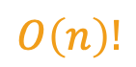
The KMP matcher
KMP-Matcher(p: String pattern, T: String text){
m = |p|;
n = |T|;
F = Compute-Prefix-Function(p);
q = 0;
for(i = 0: n-1){
while((q > 0) && (p[q] != T[i]) ){ // As long as you can’t match….
q = F[q - 1]; // Keep backtracking to find other potential matches.
}
if(p[q] == T[i]){
q++; // Update the progress of our match.
}
if(q == m) {
print “Pattern occurs with shift: ” + (i – m + 1);
q = F[q – 1]; // Don’t forget that there might be more matches! We should report them all!
}
}
}
$$O\left(n\right)!$$

Slide 24
Example
Let’s trace the KMP matcher for matching the following pattern to the following text.
 | 0 | 1 | 2 | 3 | 4 | 5 | 6 | 7 | 8 | 9 | 10 | 11 | 12 | 13 | 14 | 15 | 16 | 17
T | b | c | a | b | a | b | a | b | a | c | a | b | a | b | a | c | a | c
P | a | b | a | b | a | c | a
F | ? | ? | ? | ? | ? | ? | ?

Slide 25
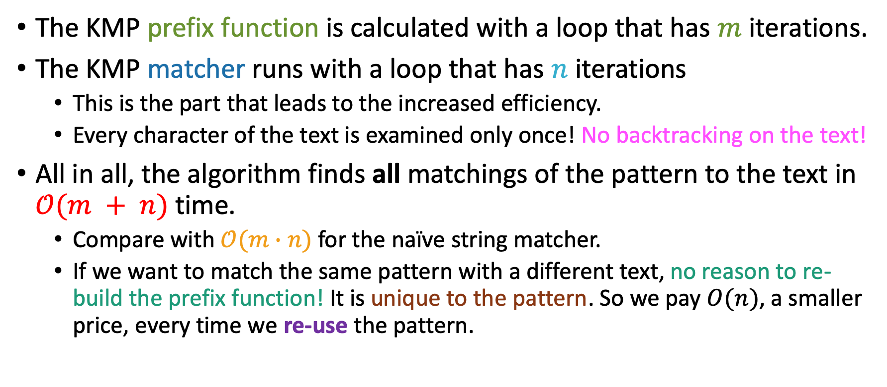
Complexity of KMP matching
The KMP prefix function is calculated with a loop that has $m$ iterations.
The KMP matcher runs with a loop that has $n$ iterations
This is the part that leads to the increased efficiency.
Every character of the text is examined only once! No backtracking on the text!
All in all, the algorithm finds all matchings of the pattern to the text in $𝒪(m + n)$ time.
Compare with $𝒪(m∙n)$ for the naïve string matcher.
If we want to match the same pattern with a different text, no reason to re-build the prefix function! It is unique to the pattern. So we pay $O(n)$, a smaller price, every time we re-use the pattern.

Slide 26
Part 2: Pre-processing the text with suffix tries and trees

Slide 27
Suffix tries
Key observation: If a pattern matches the text, it has to be the prefix of some suffix!
Examples:
“key” in “keychain”
“chain” in “keychain”
“cha” in “keychain”
We know that tries are excellent for finding prefixes!
This motivates building a trie over the string’s suffixes!

Slide 28
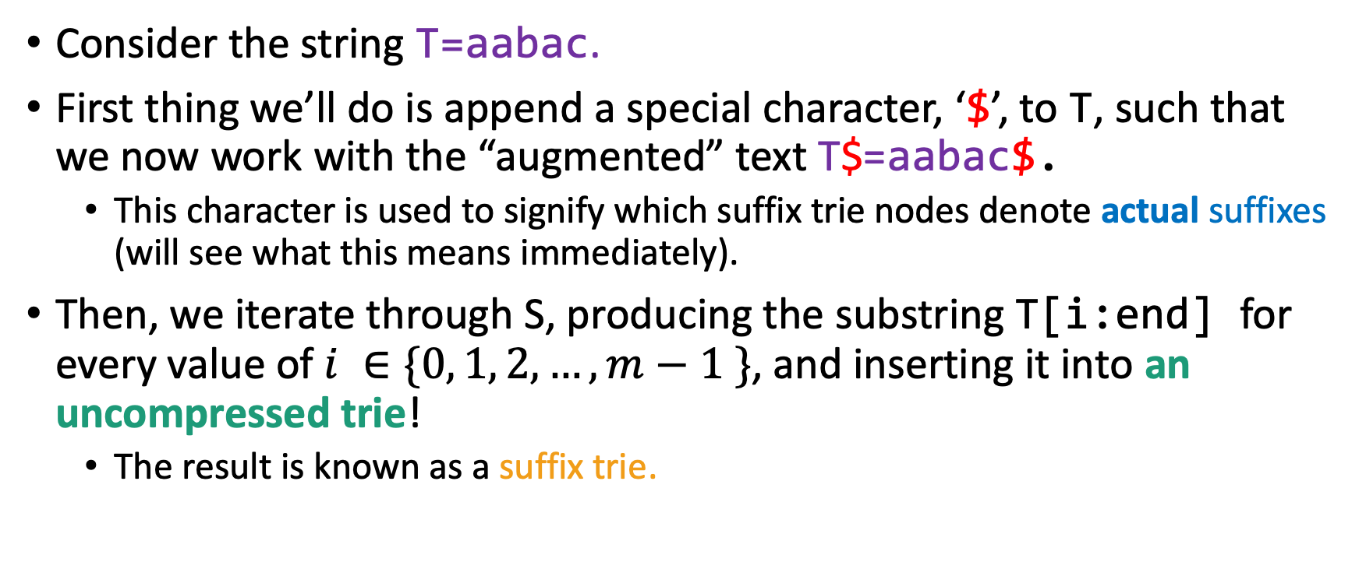
Suffix tries
Consider the string T=aabac.
First thing we’ll do is append a special character, ‘$’, to T, such that we now work with the “augmented” text T$=aabac$.
This character is used to signify which suffix trie nodes denote actual suffixes (will see what this means immediately).
Then, we iterate through S, producing the substring T[i:end] for every value of $i ∈\{0, 1, 2, …, m−1 \}$, and inserting it into an uncompressed trie!
The result is known as a suffix trie.

Slide 29
Example suffix trie
a
T=aabac$
a
b
a
c
$

Slide 30
Example suffix trie
a
T=aabac$
abac$
a
b
b
a
a
c
c
$
$

Slide 31
Example suffix trie
a
b
T=aabac$
abac$
bac$
a
b
a
b
a
c
a
c
$
c
$
$

Slide 32
Example suffix trie
a
b
T=aabac$
abac$
bac$ ac$
c
a
b
a
$
b
a
c
a
c
$
c
$
$

Slide 33
Example suffix trie
c
a
b
$
T=aabac$
abac$
bac$ ac$
c$
c
a
b
a
$
b
a
c
a
c
$
c
$
$

Slide 34
Example suffix trie
$
c
a
b
$
T=aabac$
abac$
bac$ ac$
c$
$
c
a
b
a
$
b
a
c
a
c
$
c
$
$

Slide 35
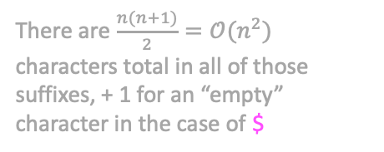
Example suffix trie
$
c
a
b
$
T=aabac$
abac$
bac$ ac$
c$
$
c
a
b
a
$
b
a
c
There are $\frac{n(n+1)}{2}=𝒪(n^{2})$ characters total in all of those suffixes, + 1 for an “empty” character in the case of $
a
c
$
c
$
$

Slide 36
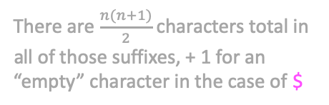
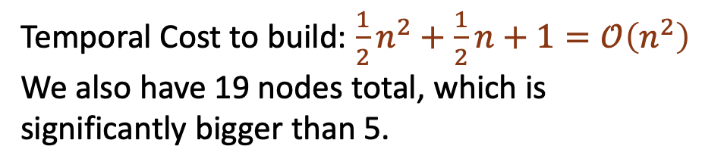
Example suffix trie
$
c
a
b
$
T=aabac$
abac$
bac$ ac$
c$
$
c
a
b
a
$
b
a
c
There are $\frac{n(n+1)}{2}$ characters total in all of those suffixes, + 1 for an “empty” character in the case of $
a
c
$
c
$
$
Temporal Cost to build: $\frac{1}{2}n^{2}+\frac{1}{2}n+1=𝒪\left(n^{2}\right)$
We also have 19 nodes total, which is significantly bigger than 5.

Slide 37
Importance of $
a
$
a
b
b
a
$
a
a
a
b
b
$
b
a
a
a
a
a
a
b
a
b
a
$
a
$
a
a
b
b
$
a
a
$
T$=abaaba$
T=abaaba

Slide 38

Importance of $
a
$
a
b
b
a
$
a
a
a
b
Getting rid of ‘$’ means that we now can no longer “read” the suffixes of the original text from our trie! So, if somebody asks us if a certain string is a suffix of the original text (important query in DNA sequencing), we cannot answer!
b
$
b
a
a
a
a
a
a
b
a
b
a
$
a
$
a
a
b
b
$
a
a
$
T$=abaaba$
T=abaaba

Slide 39
Asks, you say?
a
$
How can we use a suffix trie to….
b
a
$
a
b
$
b
a
a
a
b
a
$
$
a
b
$
a
$

Slide 40
Asks, you say?
a
$
How can we use a suffix trie to….
Check if a string S is a substring of the text T?
b
a
$
a
b
$
b
a
a
a
b
a
$
$
a
b
$
a
$

Slide 41
Asks, you say?
a
$
How can we use a suffix trie to….
Check if a string S is a substring of the text T?
Keep processing the characters of S until you either arrive at some node(S is a substring) or fall off the trie (S is not a substring).
b
a
$
a
b
$
b
a
a
a
b
a
$
$
a
b
$
a
$

Slide 42
Asks, you say?
a
$
How can we use a suffix trie to….
Check if a string S is a substring of the text T?
Keep processing the characters of S until you either arrive at some node(S is a substring) or fall off the trie (S is not a substring).
Check if a string S is a suffix of the text T?
b
a
$
a
b
$
b
a
a
a
b
a
$
$
a
b
$
a
$

Slide 43
Asks, you say?
a
$
How can we use a suffix trie to….
Check if a string S is a substring of the text T?
Keep processing the characters of S until you either arrive at some node(S is a substring) or fall off the trie (S is not a substring).
Check if a string S is a suffix of the text T?
Similar as (a), except for the fact that the node you need to arrive at to answer “Yes” has to have an outgoing edge reached by ‘$’.
b
a
$
a
b
$
b
a
a
a
b
a
$
$
a
b
$
a
$

Slide 44
Asks, you say?
a
$
How can we use a suffix trie to….
Check if a string S is a substring of the text T?
Keep processing the characters of S until you either arrive at some node(S is a substring) or fall off the trie (S is not a substring).
Check if a string S is a suffix of the text T?
Similar as (a), except for the fact that the node you need to arrive at to answer “Yes” has to have an outgoing edge reached by ‘$’.
Count the number of times a string S occurs as a substring T?
b
a
$
a
b
$
b
a
a
a
b
a
$
$
a
b
$
a
$

Slide 45
Asks, you say?
a
$
How can we use a suffix trie to….
Check if a string S is a substring of the text T?
Keep processing the characters of S until you either arrive at some node(S is a substring) or fall off the trie (S is not a substring).
Check if a string S is a suffix of the text T?
Similar as (a), except for the fact that the node you need to arrive at to answer “Yes” has to have an outgoing edge reached by ‘$’.
c) Count the number of times a string S occurs as a substring T?
Traverse the trie as in (a), hopefully reaching a node (otherwise anwer is 0), and then count the number of leaf nodes of the subtrie rooted at that node (DFS).
b
a
$
a
b
$
b
a
a
a
b
a
$
$
a
b
$
a
$

Slide 46
Asks, you say?
a
$
How can we use a suffix trie to….
Check if a string S is a substring of the text T?
Keep processing the characters of S until you either arrive at some node(S is a substring) or fall off the trie (S is not a substring).
Check if a string S is a suffix of the text T?
Similar as (a), except for the fact that the node you need to arrive at to answer “Yes” has to have an outgoing edge reached by ‘$’.
Count the number of times a string S occurs as a substring T?
Traverse the trie as in (a), hopefully reaching a node (otherwise anwer is 0), and then count the number of leaf nodes of the subtrie rooted at that node (DFS).
Find the longest repeated substring of T?
b
a
$
a
b
$
b
a
a
a
b
a
$
$
a
b
$
a
$

Slide 47
Asks, you say?
a
$
How can we use a suffix trie to….
Check if a string S is a substring of the text T?
Keep processing the characters of S until you either arrive at some node(S is a substring) or fall off the trie (S is not a substring).
Check if a string S is a suffix of the text T?
Similar as (a), except for the fact that the node you need to arrive at to answer “Yes” has to have an outgoing edge reached by ‘$’.
Count the number of times a string S occurs as a substring T?
Traverse the trie as in (a), hopefully reaching a node (otherwise anwer is 0), and then count the number of leaf nodes of the subtrie rooted at that node (DFS).
Find the longest repeated substring of T?
Deepest node with at least 2 children.
b
a
$
a
b
$
b
a
a
a
b
a
$
$
a
b
$
a
$

Slide 48
Give me the trie!
Please give us the suffix trie for the augmented text T$=aaaaaa$!

Slide 49
Give me the trie!
T=aaaaaa$ aaaaa$
aaaa$
aaa$
aa$
a$
$
a
$
a
$
a
$
a
$
a
$
a
$
$

Slide 50
Give me the trie!
T=aaaaaa$ aaaaa$
aaaa$
aaa$
aa$
a$
$
a
$
a
$
a
$
a
$
a
m=6
#nodes=14=2*6 + 2
$
a
$
$

Slide 51
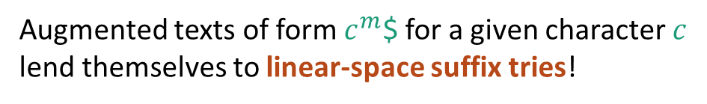
A good family of strings
c
$
m=6
#nodes=14
c
$
c
$
c
$
Augmented texts of form $c^{m}$$ for a given character $c$ lend themselves to linear-space suffix tries!
c
$
$

Slide 52
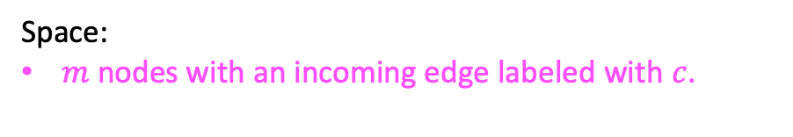
A good family of strings
c
$
m=6
#nodes=14
c
$
c
$
c
$
Augmented texts of form $c^{m}$$ for a given character $c$ lend themselves to linear-space suffix tries!
c
$
Space:
$m$ nodes with an incoming edge labeled with $c$.
$

Slide 53
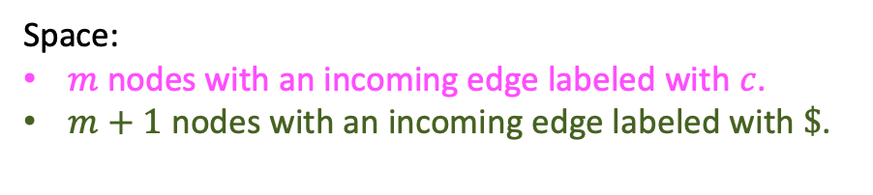
A good family of strings
c
$
m=6
#nodes=14
c
$
c
$
c
$
Augmented texts of form $c^{m}$$ for a given character $c$ lend themselves to linear-space suffix tries!
c
$
Space:
$m$ nodes with an incoming edge labeled with $c$.
$m+1$ nodes with an incoming edge labeled with $\$$.
$

Slide 54
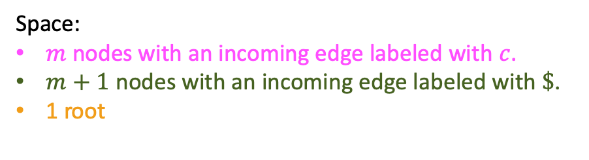
A good family of strings
c
$
m=6
#nodes=14
c
$
c
$
c
$
Augmented texts of form $c^{m}$$ for a given character $c$ lend themselves to linear-space suffix tries!
c
$
Space:
$m$ nodes with an incoming edge labeled with $c$.
$m+1$ nodes with an incoming edge labeled with $\$$.
1 root
$

Slide 55
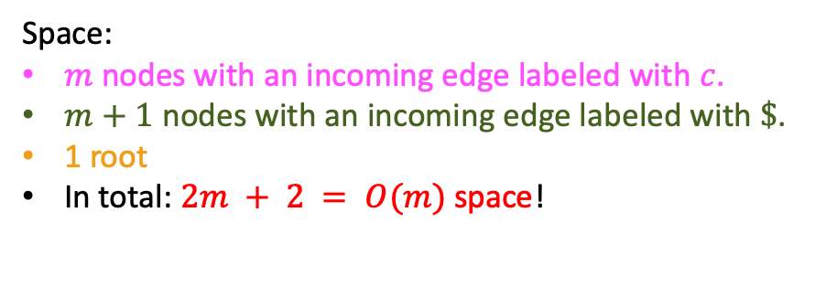
A good family of strings
c
$
m=6
#nodes=14
c
$
c
$
c
$
Augmented texts of form $c^{m}$$ for a given character $c$ lend themselves to linear-space suffix tries!
c
$
Space:
$m$ nodes with an incoming edge labeled with $c$.
$m+1$ nodes with an incoming edge labeled with $\$$.
1 root
In total: $2m + 2 = O(m)$space!
$

Slide 56

Give me the trie! Part 2
Please give us the suffix trie for the augmented text T$=aaabbb$!

Slide 57
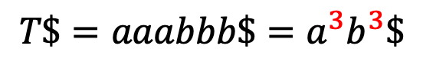
Give me the trie! Part 2
$$T\$=aaabbb\$=a^{3}b^{3}\$$$
$
a
b
b
b
a
$
b
b
b
a
$
b
b
b
$
$
b
b
$
b
$

Slide 58
Give me the trie! Part 2
$$T\$=aaabbb\$=a^{3}b^{3}\$$$
$
a
b
1 root +
b
b
a
$
b
b
b
a
$
b
b
b
$
$
b
b
$
b
$

Slide 59
Give me the trie! Part 2
$$T\$=aaabbb\$=a^{3}b^{3}\$$$
$
a
b
1 root +
3 nodes along ‘b’ chain +
b
b
a
$
b
b
b
a
$
b
b
b
$
$
b
b
$
b
$

Slide 60
Give me the trie! Part 2
$$T\$=aaabbb\$=a^{3}b^{3}\$$$
$
a
b
1 root +
3 nodes along ‘b’ chain +
b
b
a
$
b
b
b
a
$
b
b
b
$
$
b
b
$
b
$

Slide 61
Give me the trie! Part 2
$$T\$=aaabbb\$=a^{3}b^{3}\$$$
$
a
b
1 root +
3 nodes along ‘b’ chain +
3 nodes along ‘a’ chain +
b
b
a
$
b
b
b
a
$
b
b
b
$
$
b
b
$
b
$

Slide 62
Give me the trie! Part 2
$$T\$=aaabbb\$=a^{3}b^{3}\$$$
$
a
b
1 root +
3 nodes along ‘b’ chain +
3 nodes along ‘a’ chain +
b
b
a
$
b
b
b
a
$
b
b
b
$
$
b
b
$
b
$

Slide 63
Give me the trie! Part 2
$$T\$=aaabbb\$=a^{3}b^{3}\$$$
$
a
b
1 root +
3 nodes along ‘b’ chain +
3 nodes along ‘a’ chain +
3 chains of 3 ‘b’ nodes each +
b
b
a
$
b
b
b
a
$
b
b
b
$
$
b
b
$
b
$

Slide 64
Give me the trie! Part 2
$$T\$=aaabbb\$=a^{3}b^{3}\$$$
$
a
b
1 root +
3 nodes along ‘b’ chain +
3 nodes along ‘a’ chain +
3 chains of 3 ‘b’ nodes each +
2 * 3 + 1 leaves
b
b
a
$
b
b
b
a
$
b
b
b
$
$
b
b
suffix $
$
b
$

Slide 65

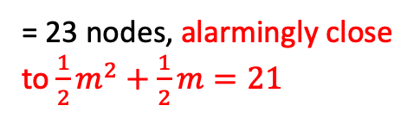
Give me the trie! Part 2
$$T\$=aaabbb\$=a^{3}b^{3}\$$$
$
a
b
1 root +
3 nodes along ‘b’ chain +
3 nodes along ‘a’ chain +
3 chains of 3 ‘b’ nodes each +
2 * 3 + 1 leaves
b
b
a
$
b
b
b
a
$
b
b
b
$
$
b
b
suffix $
$
= 23 nodes, alarmingly close to $\frac{1}{2}m^{2}+\frac{1}{2}m=21$
b
$

Slide 66
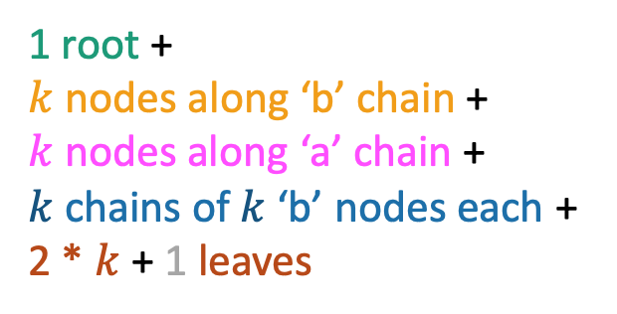
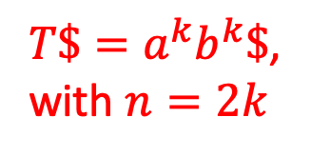
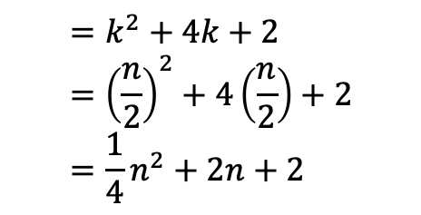
A bad family of strings
$T\$=a^{k}b^{k}\$$,
with $n=2k$
$
a
b
1 root +
$k$ nodes along ‘b’ chain +
$k$ nodes along ‘a’ chain +
$k$ chains of $k$ ‘b’ nodes each +
2 * $k$ + 1 leaves
b
b
a
$
b
b
b
a
$
b
suffix $
b
$
$$=k^{2}+4k+2={\left(\frac{n}{2}\right)}^{2}+4\left(\frac{n}{2}\right)+2 \\ =\frac{1}{4}n^{2}+2n+2$$
$
b
$

Slide 67
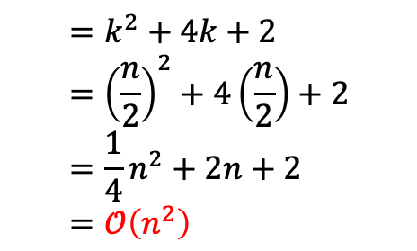
A bad family of strings
$T\$=a^{k}b^{k}\$$,
with $n=2k$
$
a
b
1 root +
$k$ nodes along ‘b’ chain +
$k$ nodes along ‘a’ chain +
$k$ chains of $k$ ‘b’ nodes each +
2 * $k$ + 1 leaves
b
b
a
$
b
b
b
a
$
b
suffix $
b
$
$$=k^{2}+4k+2={\left(\frac{n}{2}\right)}^{2}+4\left(\frac{n}{2}\right)+2 \\ =\frac{1}{4}n^{2}+2n+2 \\ =𝒪\left(n^{2}\right)$$
$
b
$

Slide 68
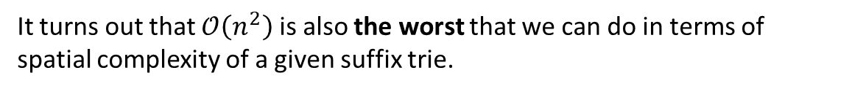
A bad family of strings
$T\$=a^{k}b^{k}\$$,
with $n=2k$
$
a
b
1 root +
$k$ nodes along ‘b’ chain +
$k$ nodes along ‘a’ chain +
$k$ chains of $k$ ‘b’ nodes each +
2 * $k$ + 1 leaves
b
b
a
$
b
b
b
a
$
b
suffix $
b
$
$$=k^{2}+4k+2={\left(\frac{n}{2}\right)}^{2}+4\left(\frac{n}{2}\right)+2 \\ =\frac{1}{4}n^{2}+2n+2 \\ =𝒪\left(n^{2}\right)$$
$
b
$
It turns out that $𝒪\left(n^{2}\right)$ is also the worst that we can do in terms of spatial complexity of a given suffix trie.

Slide 69
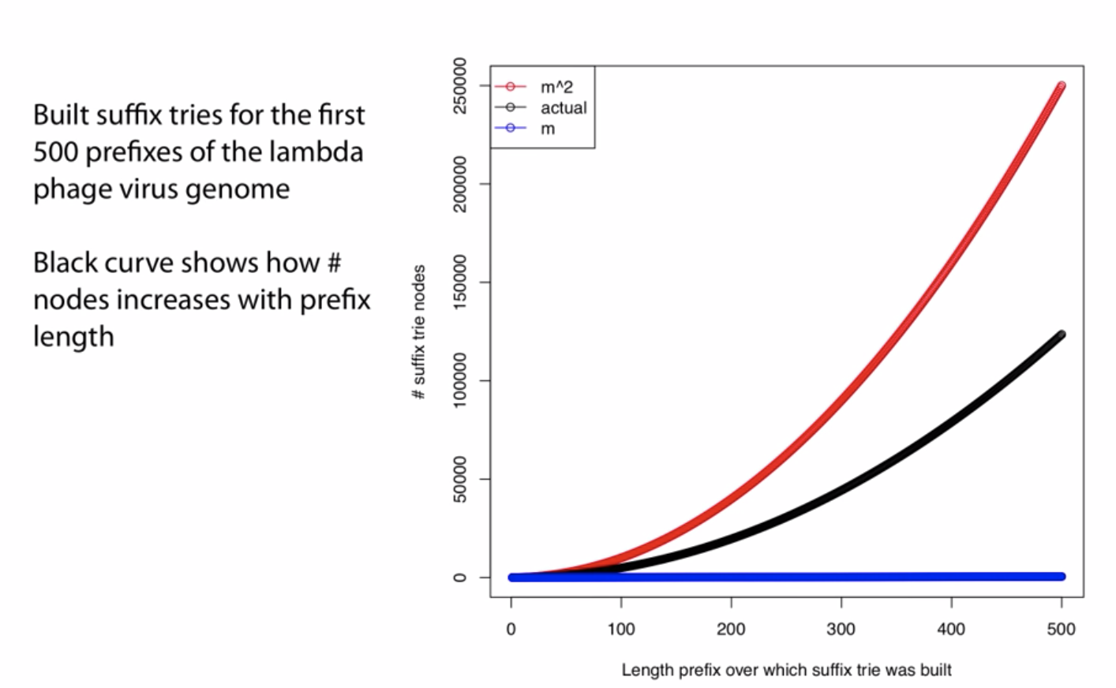
Spatial cost in practice
Graph Credit: Ben Langmead, JHU

Slide 70
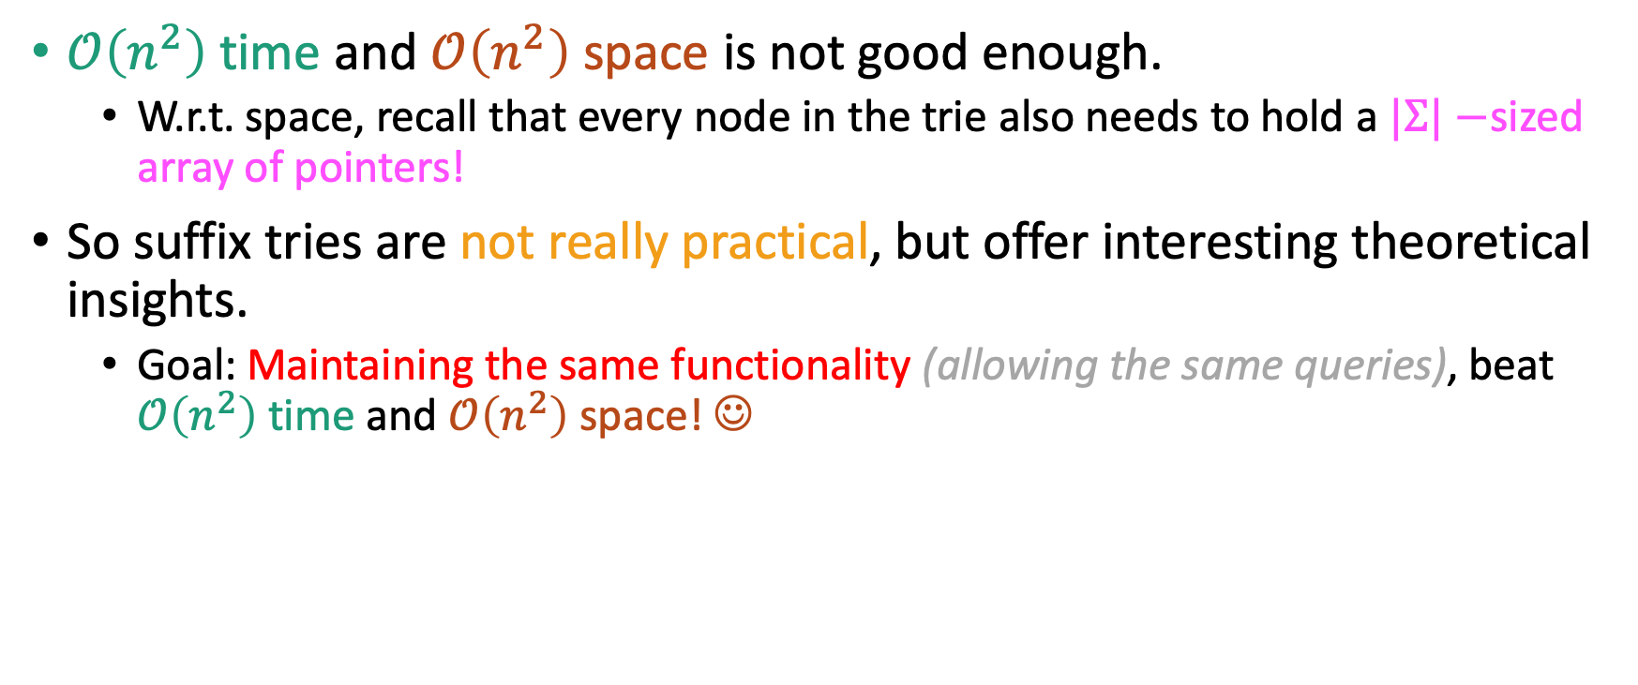
Suffix Tries – not good enough!
$𝒪\left(n^{2}\right)$ time and $𝒪\left(n^{2}\right)$ space is not good enough.
W.r.t. space, recall that every node in the trie also needs to hold a $|Σ|−$sized array of pointers!
So suffix tries are not really practical, but offer interesting theoretical insights.
Goal: Maintaining the same functionality (allowing the same queries), beat $𝒪\left(n^{2}\right)$ time and $𝒪\left(n^{2}\right)$ space! ☺

Slide 71
Suffix Trees
A suffix tree is a compressed (Patricia) suffix trie with some additional bells and whistles.
a
$
a
$
b
b
a
$
a
aba$
$
a
b
$
ba
$
b
a
a
a
aba$
b
a
$
aba$
$
$
a
b
$
a
$

Slide 72
# nodes in a suffix tree
a
$
We saw that suffix tries have $O(n^{2})$ nodes…
b
a
$
a
b
$
a
a
a
b
a
$
$
a
b
$
a
$

Slide 73

# nodes in a suffix tree
a
$
We saw that suffix tries have $O(n^{2})$ nodes… which is not acceptable in practice.
b
a
$
a
b
$
a
a
a
b
a
$
$
a
b
$
a
$

Slide 74
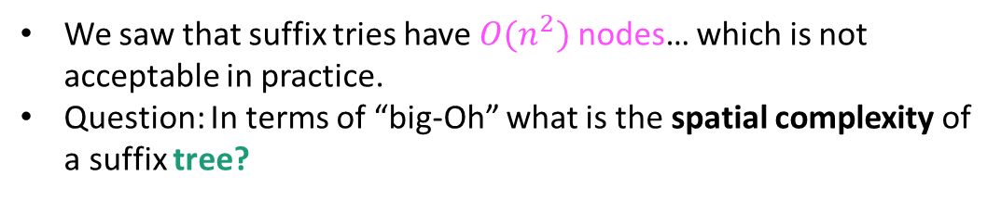
# nodes in a suffix tree
We saw that suffix tries have $O(n^{2})$ nodes… which is not acceptable in practice.
Question: In terms of “big-Oh” what is the spatial complexity of a suffix tree?
a
$
aba$
ba
$
ba
$
aba$
aba$
$

Slide 75


# nodes in a suffix tree
We saw that suffix tries have $𝒪(n^{2})$ nodes… which is not acceptable in practice.
Question: In terms of “big-Oh” what is the spatial complexity of a suffix tree?
a
$
ba
aba$
$
ba
$
aba$
$$𝒪(n^{2})$$
Better
Worse
aba$
$

Slide 76

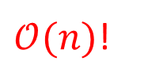
# nodes in a suffix tree
We saw that suffix tries have $𝒪(n^{2})$ nodes… which is not acceptable in practice.
Question: In terms of “big-Oh” what is the spatial complexity of a suffix tree?
a
$
ba
aba$
$
ba
$
$𝒪(n)$!
aba$
$$𝒪(n^{2})$$
Better
Worse
aba$
$

Slide 77
# nodes in a suffix tree
We saw that suffix tries have $𝒪(n^{2})$ nodes… which is not acceptable in practice.
Question: In terms of “big-Oh” what is the spatial complexity of a suffix tree?
a
$
ba
aba$
$
ba
$
$𝒪(n)$!
aba$
$$𝒪(n^{2})$$
Worse
Better
aba$
$
For text of length $n,$ there are $n+1$ leaf nodes

Slide 78
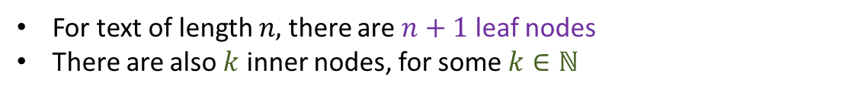
# nodes in a suffix tree
We saw that suffix tries have $𝒪(n^{2})$ nodes… which is not acceptable in practice.
Question: In terms of “big-Oh” what is the spatial complexity of a suffix tree?
a
$
ba
aba$
$
ba
$
$𝒪(n)$!
aba$
$$𝒪(n^{2})$$
Better
Worse
aba$
$
For text of length $n,$ there are $n+1$ leaf nodes
There are also $k$ inner nodes, for some $k∈ℕ$

Slide 79
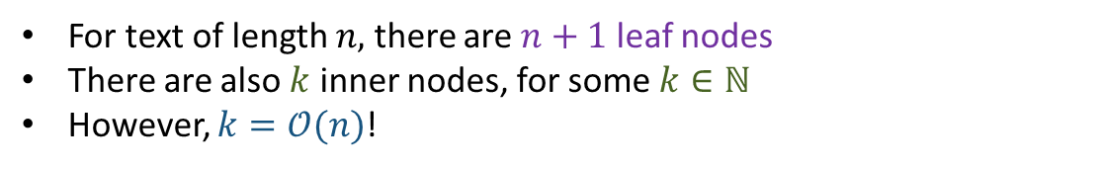
# nodes in a suffix tree
We saw that suffix tries have $𝒪(n^{2})$ nodes… which is not acceptable in practice.
Question: In terms of “big-Oh” what is the spatial complexity of a suffix tree?
a
$
ba
aba$
$
ba
$
$𝒪(n)$!
aba$
$$𝒪(n^{2})$$
Better
Worse
aba$
$
For text of length $n,$ there are $n+1$ leaf nodes
There are also $k$ inner nodes, for some $k∈ℕ$
However, $k=𝒪(n)$!

Slide 80
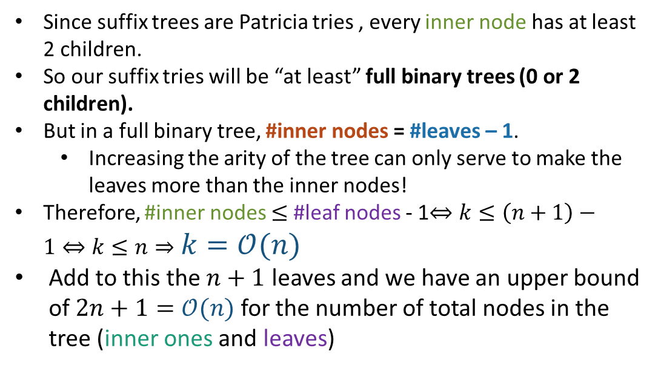

Why $k=𝒪(n)$
Since suffix trees are Patricia tries , every inner node has at least 2 children.
So our suffix tries will be “at least” full binary trees (0 or 2 children).
But in a full binary tree, #inner nodes = #leaves – 1.
Increasing the arity of the tree can only serve to make the leaves more than the inner nodes!
Therefore, #inner nodes $≤$ #leaf nodes - 1$⇔k≤\left(n+1\right)−1⇔k≤n⇒k=𝒪(n)$
Add to this the $n+1$ leaves and we have an upper bound of $2n+1=𝒪(n)$ for the number of total nodes in the tree (inner ones and leaves)
a
$
ba
aba$
$
ba
$
aba$
aba$
$

Slide 81
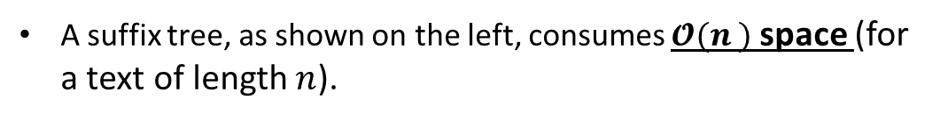
Quiz time!
A suffix tree, as shown on the left, consumes $𝓞(n^{ })$ space (for a text of length $n$).
a
$
aba$
ba
False
$
True
ba
$
aba$
aba$
$

Slide 82

Quiz time!
Inserting quadratically many substrings ☹
A suffix tree, as shown on the left, consumes $𝓞(n^{ })$ space (for a text of length $n$).
a
$
aba$
ba
False
$
True
ba
$
aba$
aba$
$

Slide 83
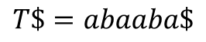
Quiz time!
$$T\$=abaaba\$$$
A suffix tree, as shown on the left, consumes $𝓞(n^{ })$ space (for a text of length $n$).
a
$
aba$
ba
False
$
True
ba
$
aba$
aba$
$
Solution: Instead of actual characters (like in a Patricia Trie), store two integers, offset and length, in every node.
Those will be the offset from 0 and length of the substring the way it appears in T$.
Consistent with what the structure would be used for (string matching).

Slide 84

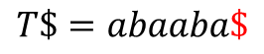
Quiz time!
$$T\$=abaaba\$$$
A suffix tree, as shown on the left, consumes $𝓞(n^{ })$ space (for a text of length $n$).
a
(6, 1)
aba$
ba
False
(6, 1)
True
ba
(6, 1)
aba$
aba$
(6, 1)
Solution: Instead of actual characters (like in a Patricia Trie), store two integers, offset and length, in every node.
Those will be the offset from 0 and length of the substring the way it appears in T$.
Consistent with what the structure would be used for (string matching).

Slide 85

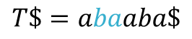
Quiz time!
$$T\$=abaaba\$$$
A suffix tree, as shown on the left, consumes $𝓞(n^{ })$ space (for a text of length $n$).
a
(6, 1)
aba$
(1, 2)
True
False
(6, 1)
(1, 2)
(6, 1)
aba$
aba$
(6, 1)
Solution: Instead of actual characters (like in a Patricia Trie), store two integers, offset and length, in every node.
Those will be the offset from 0 and length of the substring the way it appears in T$.
Consistent with what the structure would be used for (string matching).

Slide 86


Quiz time!
$$T\$=abaaba\$$$
A suffix tree, as shown on the left, consumes $𝓞(n^{ })$ space (for a text of length $n$).
a
(6, 1)
(3, 4)
(1, 2)
True
False
(6, 1)
(1, 2)
(6, 1)
(3, 4)
(6, 1)
(3, 4)
Solution: Instead of actual characters (like in a Patricia Trie), store two integers, offset and length, in every node.
Those will be the offset from 0 and length of the substring the way it appears in T$.
Consistent with what the structure would be used for (string matching).

Slide 87

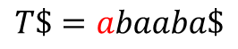
Quiz time!
$$T\$=abaaba\$$$
A suffix tree, as shown on the left, consumes $𝓞(n^{ })$ space (for a text of length $n$).
(0, 1)
(6, 1)
(3, 4)
(1, 2)
True
False
(6, 1)
(1, 2)
(6, 1)
(3, 4)
(6, 1)
(3, 4)
Solution: Instead of actual characters (like in a Patricia Trie), store two integers, offset and length, in every node.
Those will be the offset from 0 and length of the substring the way it appears in T$.
Consistent with what the structure would be used for (string matching).

Slide 88
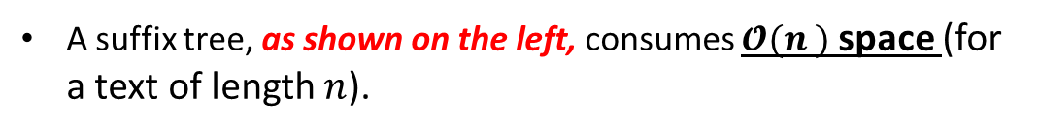
Quiz time!
$$T\$=abaaba\$$$
A suffix tree, as shown on the left, consumes $𝓞(n^{ })$ space (for a text of length $n$).
(0, 1)
(6, 1)
(3, 4)
(1, 2)
True
False
(6, 1)
(1, 2)
(6, 1)
(3, 4)
(6, 1)
(3, 4)

Slide 89
Quiz time!
$$T\$=abaaba\$$$
A suffix tree, as shown on the left, consumes $𝓞(n^{ })$ space (for a text of length $n$).
(0, 1)
(6, 1)
(3, 4)
(1, 2)
True
False
(6, 1)
(1, 2)
(6, 1)
(3, 4)
(6, 1)
Final tweak: The leaf nodes will be associated with the (zero-indexed) offsets of the entire suffixes to which they correspond.
Recall that the per-inner-node offsets we have stored concern the offsets of substrings of these suffixes.
(3, 4)

Slide 90
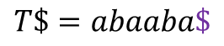
Quiz time!
$$T\$=abaaba\$$$
A suffix tree, as shown on the left, consumes $𝓞(n^{ })$ space (for a text of length $n$).
(0, 1)
(6, 1)
(3, 4)
(1, 2)
6
True
False
(6, 1)
(1, 2)
(6, 1)
(3, 4)
(6, 1)
Final tweak: The leaf nodes will be associated with the (zero-indexed) offsets of the entire suffixes to which they correspond.
Recall that the per-inner-node offsets we have stored concern the offsets of substrings of these suffixes.
(3, 4)

Slide 91
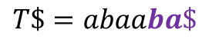
Quiz time!
$$T\$=abaaba\$$$
A suffix tree, as shown on the left, consumes $𝓞(n^{ })$ space (for a text of length $n$).
(0, 1)
(6, 1)
(3, 4)
(1, 2)
6
True
False
(6, 1)
(1, 2)
(6, 1)
(3, 4)
4
(6, 1)
Final tweak: The leaf nodes will be associated with the (zero-indexed) offsets of the entire suffixes to which they correspond.
Recall that the per-inner-node offsets we have stored concern the offsets of substrings of these suffixes.
(3, 4)

Slide 92
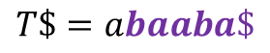
Quiz time!
$$T\$=abaaba\$$$
A suffix tree, as shown on the left, consumes $𝓞(n^{ })$ space (for a text of length $n$).
(0, 1)
(6, 1)
(3, 4)
(1, 2)
6
True
False
(6, 1)
(1, 2)
(6, 1)
(3, 4)
4
(6, 1)
Final tweak: The leaf nodes will be associated with the (zero-indexed) offsets of the entire suffixes to which they correspond.
Recall that the per-inner-node offsets we have stored concern the offsets of substrings of these suffixes.
(3, 4)
1

Slide 93
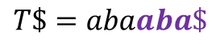
Quiz time!
$$T\$=abaaba\$$$
A suffix tree, as shown on the left, consumes $𝓞(n^{ })$ space (for a text of length $n$).
(0, 1)
(6, 1)
(3, 4)
(1, 2)
6
True
False
(6, 1)
(1, 2)
(6, 1)
(3, 4)
4
(6, 1)
Final tweak: The leaf nodes will be associated with the (zero-indexed) offsets of the entire suffixes to which they correspond.
Recall that the per-inner-node offsets we have stored concern the offsets of substrings of these suffixes.
(3, 4)
1
3

Slide 94
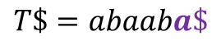
Quiz time!
$$T\$=abaaba\$$$
A suffix tree, as shown on the left, consumes $𝓞(n^{ })$ space (for a text of length $n$).
(0, 1)
(6, 1)
(3, 4)
(1, 2)
6
True
False
(6, 1)
(1, 2)
5
(6, 1)
(3, 4)
4
(6, 1)
Final tweak: The leaf nodes will be associated with the (zero-indexed) offsets of the entire suffixes to which they correspond.
Recall that the per-inner-node offsets we have stored concern the offsets of substrings of these suffixes.
(3, 4)
1
3

Slide 95
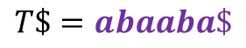
Quiz time!
$$T\$=abaaba\$$$
A suffix tree, as shown on the left, consumes $𝓞(n^{ })$ space (for a text of length $n$).
(0, 1)
(6, 1)
(3, 4)
(1, 2)
6
True
False
(6, 1)
(1, 2)
5
(6, 1)
(3, 4)
4
(6, 1)
Final tweak: The leaf nodes will be associated with the (zero-indexed) offsets of the entire suffixes to which they correspond.
Recall that the per-inner-node offsets we have stored concern the offsets of substrings of these suffixes.
(3, 4)
1
3
0

Slide 96
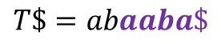
Quiz time!
$$T\$=abaaba\$$$
A suffix tree, as shown on the left, consumes $𝓞(n^{ })$ space (for a text of length $n$).
(0, 1)
(6, 1)
(3, 4)
(1, 2)
6
True
False
(6, 1)
(1, 2)
5
2
(6, 1)
(3, 4)
4
(6, 1)
Final tweak: The leaf nodes will be associated with the (zero-indexed) offsets of the entire suffixes to which they correspond.
Recall that the per-inner-node offsets we have stored concern the offsets of substrings of these suffixes.
(3, 4)
1
3
0

Slide 97
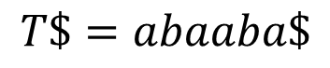
Using a suffix tree
How can we use a suffix tree to….
(0, 1)
(6, 1)
(3, 4)
(1, 2)
6
(6, 1)
(1, 2)
5
2
(6, 1)
(3, 4)
4
(6, 1)
1
(3, 4)
3
0
$$T\$=abaaba\$$$

Slide 98
Using a suffix tree
How can we use a suffix tree to….
Check if a string S is a substring of the text T?
(0, 1)
(6, 1)
(3, 4)
(1, 2)
6
(6, 1)
(1, 2)
5
2
(6, 1)
(3, 4)
4
(6, 1)
1
(3, 4)
3
0
$$T\$=abaaba\$$$

Slide 99
Using a suffix tree
How can we use a suffix tree to….
Check if a string S is a substring of the text T?
Consume the input string by chopping away “length”-many characters at every node, and following the link corresponding to the next character. If we don’t fall of the tree through any of these links, we answer “yes”. If we consume the entire string before traversing an outgoing link from a node, we also answer “yes”. Otherwise, “no”.
(0, 1)
(6, 1)
(3, 4)
(1, 2)
6
(6, 1)
(1, 2)
5
2
(6, 1)
(3, 4)
4
(6, 1)
1
(3, 4)
3
0
$$T\$=abaaba\$$$

Slide 100
Using a suffix tree
How can we use a suffix tree to….
Check if a string S is a substring of the text T?
Consume the input string by chopping away “length”-many characters at every node, and following the link corresponding to the next character. If we don’t fall of the tree through any of these links, we answer “yes”. If we consume the entire string before traversing an outgoing link from a node, we also answer “yes”. Otherwise, “no”.
Check if a string S is a suffix of the text T?
(0, 1)
(6, 1)
(3, 4)
(1, 2)
6
(6, 1)
(1, 2)
5
2
(6, 1)
(3, 4)
4
(6, 1)
1
(3, 4)
3
0
$$T\$=abaaba\$$$

Slide 101
Using a suffix tree
How can we use a suffix tree to….
Check if a string S is a substring of the text T?
Consume the input string by chopping away “length”-many characters at every node, and following the link corresponding to the next character. If we don’t fall of the tree through any of these links, we answer “yes”. If we consume the entire string before traversing an outgoing link from a node, we also answer “yes”. Otherwise, “no”.
Check if a string S is a suffix of the text T?
The entire string needs to have been consumed by the various nodes’ length parameters, and there needs to be an outgoing edge labeled ‘$’.
(0, 1)
(6, 1)
(3, 4)
(1, 2)
6
(6, 1)
(1, 2)
5
2
(6, 1)
(3, 4)
4
(6, 1)
1
(3, 4)
3
0
$$T\$=abaaba\$$$

Slide 102
Using a suffix tree
How can we use a suffix tree to….
Check if a string S is a substring of the text T?
Consume the input string by chopping away “length”-many characters at every node, and following the link corresponding to the next character. If we don’t fall of the tree through any of these links, we answer “yes”. If we consume the entire string before traversing an outgoing link from a node, we also answer “yes”. Otherwise, “no”.
Check if a string S is a suffix of the text T?
The entire string needs to have been consumed by the various nodes’ length parameters, and there needs to be an outgoing edge labeled ‘$’.
Count the number of times a string S occurs as a substring of T?
(0, 1)
(6, 1)
(3, 4)
(1, 2)
6
(6, 1)
(1, 2)
5
2
(6, 1)
(3, 4)
4
(6, 1)
1
(3, 4)
3
0
$$T\$=abaaba\$$$

Slide 103
Using a suffix tree
How can we use a suffix tree to….
Check if a string S is a substring of the text T?
Consume the input string by chopping away “length”-many characters at every node, and following the link corresponding to the next character. If we don’t fall of the tree through any of these links, we answer “yes”. If we consume the entire string before traversing an outgoing link from a node, we also answer “yes”. Otherwise, “no”.
Check if a string S is a suffix of the text T?
The entire string needs to have been consumed by the various nodes’ length parameters, and there needs to be an outgoing edge labeled ‘$’.
Count the number of times a string S occurs as a substring of T?
By using the strictly positive “length” parameter of any given node, at some point we will exhaust S, either “at a node” or “at an edge” (length parameter longer than residual string). In either case, the solution is the #leaf nodes underneath the relevant node’s subtree.
(0, 1)
(6, 1)
(3, 4)
(1, 2)
6
(6, 1)
(1, 2)
5
2
(6, 1)
(3, 4)
4
(6, 1)
1
(3, 4)
3
0
$$T\$=abaaba\$$$

Slide 104
Using a suffix tree
How can we use a suffix tree to….
Check if a string S is a substring of the text T?
Consume the input string by chopping away “length”-many characters at every node, and following the link corresponding to the next character. If we don’t fall of the tree through any of these links, we answer “yes”. If we consume the entire string before traversing an outgoing link from a node, we also answer “yes”. Otherwise, “no”.
Check if a string S is a suffix of the text T?
The entire string needs to have been consumed by the various nodes’ length parameters, and there needs to be an outgoing edge labeled ‘$’.
Count the number of times a string S occurs as a substring of T?
By using the strictly positive “length” parameter of any given node, at some point we will exhaust S, either “at a node” or “at an edge” (length parameter longer than residual string). In either case, the solution is the #leaf nodes underneath the relevant node’s subtree.
Find the longest repeated substring of T?
(0, 1)
(6, 1)
(3, 4)
(1, 2)
6
(6, 1)
(1, 2)
5
2
(6, 1)
(3, 4)
4
(6, 1)
1
(3, 4)
3
0
$$T\$=abaaba\$$$

Slide 105
Using a suffix tree
How can we use a suffix tree to….
Check if a string S is a substring of the text T?
Consume the input string by chopping away “length”-many characters at every node, and following the link corresponding to the next character. If we don’t fall of the tree through any of these links, we answer “yes”. If we consume the entire string before traversing an outgoing link from a node, we also answer “yes”. Otherwise, “no”.
Check if a string S is a suffix of the text T?
The entire string needs to have been consumed by the various nodes’ length parameters, and there needs to be an outgoing edge labeled ‘$’.
Count the number of times a string S occurs as a substring of T?
By using the strictly positive “length” parameter of any given node, at some point we will exhaust S, either “at a node” or “at an edge” (length parameter longer than residual string). In either case, the solution is the #leaf nodes underneath the relevant node’s subtree.
Find the longest repeated substring of T?
Similar to suffix tries, we need to find the “deepest” node with at least two children.
(0, 1)
(6, 1)
(3, 4)
(1, 2)
6
(6, 1)
(1, 2)
5
2
(6, 1)
(3, 4)
4
(6, 1)
1
(3, 4)
3
0
$$T\$=abaaba\$$$

Slide 106
Suffix trees – you try them out!
Give me the suffix tree for the text T=xxyzxzy.

Slide 107
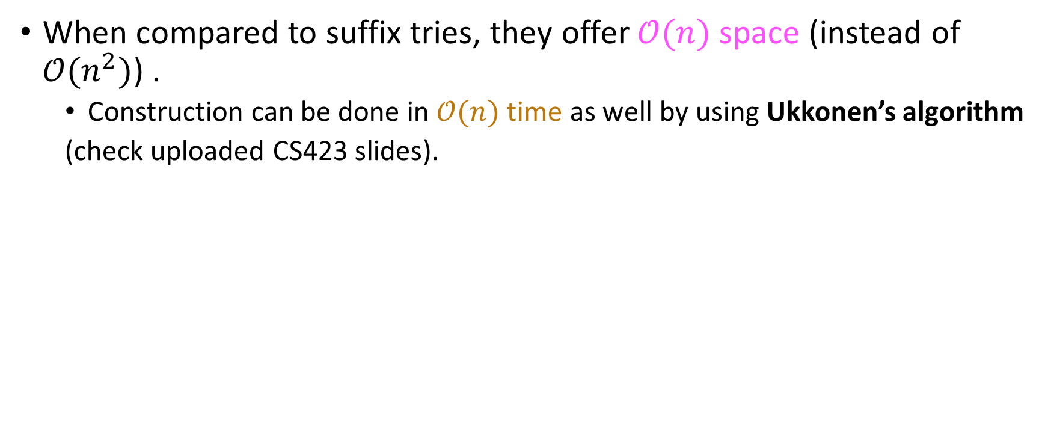
Analysis of suffix trees
When compared to suffix tries, they offer $𝒪(n)$ space (instead of $𝒪(n^{2})$) .
Construction can be done in $𝒪(n)$ time as well by using Ukkonen’s algorithm
(check uploaded CS423 slides).

Slide 108

Analysis of suffix trees
When compared to suffix tries, they offer $𝒪(n)$ space (instead of $𝒪(n^{2})$) .
Construction can be done in $𝒪(n)$ time as well by using Ukkonen’s algorithm
(check uploaded CS423 slides).
One issue: Space might be $𝒪(n)$ , but it has an unfavorable constant up front.
Recall: every node needs a $| Σ |$- sized array of links, two integers, and possible suffix links (those are required by Ukkonen’s algorithm)

Slide 109

Analysis of suffix trees
When compared to suffix tries, they offer $𝒪(n)$ space (instead of $𝒪(n^{2})$) .
Construction can be done in $𝒪(n)$ time as well by using Ukkonen’s algorithm
(check uploaded CS423 slides).
One issue: Space might be $𝒪(n)$ , but it has an unfavorable constant up front.
Recall: every node needs a $| Σ |$- sized array of links, two integers, and possible suffix links (those are required by Ukkonen’s algorithm)
Goal: reproduce functionality while lowering space cost ☺

Slide 110
Part 3: Pre-processing the text with suffix arrays

Slide 111
Suffix arrays
Given a text T, a suffix array is a single-dimensional array of lexicographically sorted suffixes of T$.

Slide 112
Suffix arrays
Given a text T, a suffix array is a single-dimensional array of lexicographically sorted suffixes of T$.
Example: consider the string T=jason.

Slide 113
Suffix arrays
Given a text T, a suffix array is a single-dimensional array of lexicographically sorted suffixes of T$.
Example: consider the string T=jason.
Suffixes | Suffix array
$ | $
n$ | ason$
on$ | jason$
son$ | n$
ason$ | on$
jason$ | son$

Slide 114
Suffix arrays
Given a text T, a suffix array is a single-dimensional array of lexicographically sorted suffixes of T$.
Example: consider the string T$=jason$ .
To avoid storing quadratically many characters, replace suffixes with offsets into augmented string!
Suffixes | Suffix array
$ | 5 $
n$ | 1 ason$
on$ | 0 jason$
son$ | 4 n$
ason$ | 3 on$
jason$ | 2 son$

Slide 115
Suffix arrays
Given a text T, a suffix array is a single-dimensional array of lexicographically sorted suffixes of T$.
Example: consider the string T$=jason$ .
To avoid storing quadratically many characters, replace suffixes with offsets into augmented string!
Suffixes | Suffix array
$ | 5
n$ | 1
on$ | 0
son$ | 4
ason$ | 3
jason$ | 2
Space cost: $𝒪(n)$ with a far better constant up front (4, for size of int)

Slide 116

Building a suffix array
Build the suffix tree and do an inorder traversal. Because this traversal is sorted traversal in Patricia tries, every time you encounter a string you insert it in SuffArr[i++].
Makes sense if you have a suffix tree that you want to ditch.
Recall: Suffix tree built in $O(n)$ time through Ukkonen’s algorithm and consumes $O(n)$ space, but with a bad constant up front.
Insert all the strings into an array which you then sort in-place.
$O(n)$ space
$O(n\log_{2}{n})$ time
Notes:
Would it be necessary for the sorting algorithm here to be stable?

Slide 117
Building a suffix array
Build the suffix tree and do an inorder traversal. Because this traversal is sorted traversal in Patricia tries, every time you encounter a string you insert it in SuffArr[i++].
Makes sense if you have a suffix tree that you want to ditch.
Recall: Suffix tree built in $O(n)$ time through Ukkonen’s algorithm and consumes $O(n)$ space, but with a bad constant up front.
Insert all the strings into an array which you then sort in-place.
$O(n)$ space
$O(n\log_{2}{n})$ time
True or False: For approach #2, I would need a stable sorting algorithm

Slide 118
Building a suffix array
Build the suffix tree and do an inorder traversal. Because this traversal is sorted traversal in Patricia tries, every time you encounter a string you insert it in SuffArr[i++].
Makes sense if you have a suffix tree that you want to ditch.
Recall: Suffix tree built in $O(n)$ time through Ukkonen’s algorithm and consumes $O(n)$ space, but with a bad constant up front.
Insert all the strings into an array which you then sort in-place.
$O(n)$ space
$O(n\log_{2}{n})$ time
True or False: For approach #2, I would need a stable sorting algorithm
True
False
Who cares?

Slide 119

Building a suffix array
Build the suffix tree and do an inorder traversal. Because this traversal is sorted traversal in Patricia tries, every time you encounter a string you insert it in SuffArr[i++].
Makes sense if you have a suffix tree that you want to ditch.
Recall: Suffix tree built in $O(n)$ time through Ukkonen’s algorithm and consumes $O(n)$ space, but with a bad constant up front.
Insert all the strings into an array which you then sort in-place.
$O(n)$ space
$O(n\log_{2}{n})$ time
True or False: For approach #2, I would need a stable sorting algorithm
True
False
Who cares?
Since you store different-length suffixes, there will never be a tie… Either mergesort or quicksort will do!

Slide 120
Using a suffix array
We will use suffix arrays exclusively for the problem of string matching.
I.e we will not reproduce the full functionality of suffix trees, sticking with the most fundamental functionality.
Extensions of suffix arrays, like the LCP array, allow for the full functionality of suffix trees with similar gains in space.

Slide 121
Using a suffix array
We will use suffix arrays exclusively for the problem of string matching.
I.e we will not reproduce the full functionality of suffix trees, sticking with the most fundamental functionality.
Extensions of suffix arrays, like the LCP array, allow for the full functionality of suffix trees with similar gains in space.
Key requirement: we need all matches and their original text offsets!

Slide 122
Using a suffix array
We will use suffix arrays exclusively for the problem of string matching.
I.e we will not reproduce the full functionality of suffix trees, sticking with the most fundamental functionality.
Extensions of suffix arrays, like the LCP array, allow for the full functionality of suffix trees with similar gains in space.
Key requirement: we need all matches and their original text offsets!
Key observation: if P occurs in T, then all its occurrences in the suffix array are consecutive!

Slide 123
Using a suffix array
We will use suffix arrays exclusively for the problem of string matching.
I.e we will not reproduce the full functionality of suffix trees, sticking with the most fundamental functionality.
Extensions of suffix arrays, like the LCP array, allow for the full functionality of suffix trees with similar gains in space.
Key requirement: we need all matches and their original text offsets!
Key observation: if P occurs in T, then all its occurrences in the suffix array are consecutive!
We can find the end-points of this interval with two binary searches in the suffix array!

Slide 124
Pseudocode
function printMatches(T:text, P:pattern){
n = |T|; m = |P|;
A = createSuffixArray(T); // Pre-processing the text!
left = 0; right = n;
while(left < right) {
mid = (left + right) / 2;
if(P > T[A[mid]]) // Pattern lexicographically *smaller* than text at A[mid] (closer to ‘Z’)
left = mid + 1; // Right subarray
else
right = mid; // Left subarray;
}
/* Done with first search; Variable left now has the left end of the interval. * We execute another binary search to find the right end-point. */
start = left; right = n;
while(left < right){
mid = (left + right)/ 2:
if(P < T[A[mid]]) // Pattern lexicographically *greater* than text at A[mid] (closer to `A’)
right = mid;
else
left = mid + 1;
}
end = right + 1;
printFunc(A, start, end);
}
function printFunc(A: suffix array, start: int, end:int) {
assert 0 <= start <= end < A.length // Requirements for this to work
for(int i = start; i <= end; i ++){
print “Pattern occurs in text in index: “ + A[i]
}
}

Slide 125
Example: T=quixoticelixir (band name)
Current array indices | Suffix array indices for T$=quixoticelixir$ | Actual suffixes of T$=quixoticelixir$ (would not be stored in practice, denoted just for clarity)
0 | 14 | $
1 | 7 | celixir$
2 | 8 | elixir$
3 | 6 | icelixir$
4 | 12 | ir$
5 | 10 | ixir$
6 | 2 | ixoticelixir$
7 | 9 | lixir$
8 | 4 | oticelixir$
9 | 0 | quixoticelixir$
10 | 13 | r$
11 | 5 | ticelixir$
12 | 1 | uixoticelixir$
13 | 11 | xir$
14 | 3 | xoticelixir$

Slide 126
Example: T=quixoticelixir (band name)
Search for “ix”
Current array indices | Suffix array indices for T$=quixoticelixir$ | Actual suffixes of T$=quixoticelixir$ (would not be stored in practice, denoted just for clarity)
0 | 14 | $
1 | 7 | celixir$
2 | 8 | elixir$
3 | 6 | icelixir$
4 | 12 | ir$
5 | 10 | ixir$
6 | 2 | ixoticelixir$
7 | 9 | lixir$
8 | 4 | oticelixir$
9 | 0 | quixoticelixir$
10 | 13 | r$
11 | 5 | ticelixir$
12 | 1 | uixoticelixir$
13 | 11 | xir$
14 | 3 | xoticelixir$

Slide 127
Example: T=quixoticelixir (band name)
Search for “ix”
Note that indices are consecutive in array…
Current array indices | Suffix array indices for T$=quixoticelixir$ | Actual suffixes of T$=quixoticelixir$ (would not be stored in practice, denoted just for clarity)
0 | 14 | $
1 | 7 | celixir$
2 | 8 | elixir$
3 | 6 | icelixir$
4 | 12 | ir$
5 | 10 | ixir$
6 | 2 | ixoticelixir$
7 | 9 | lixir$
8 | 4 | oticelixir$
9 | 0 | quixoticelixir$
10 | 13 | r$
11 | 5 | ticelixir$
12 | 1 | uixoticelixir$
13 | 11 | xir$
14 | 3 | xoticelixir$

Slide 128
Your turn
Build the suffix array for “mississippi”.
Then, simulate the search for “is”.

Slide 129

Analysis
Suppose $\left|T\right|=n$ and $\left|P\right|=m$.
Then, the computational complexity of finding all occurrences of $P$ in $M$ is…

Slide 130



Analysis
Suppose $\left|T\right|=n$ and $\left|P\right|=m$.
Then, the computational complexity of finding all occurrences of $P$ in $M$ is…
$$𝒪(\log_{2}{n})$$
$$𝒪({m⋅log}_{2}{n})$$
$$𝒪({n⋅log}_{2}{m})$$
Something else (what?)

Slide 131

Analysis
Suppose $\left|T\right|=n$ and $\left|P\right|=m$.
Then, the computational complexity of finding all occurrences of $P$ in $M$ is…
Constant up front: 2, since we execute 2 binary searches.
The $m$ comes to be because of the fact that we do an $m$- length comparison (strncmp) every time we compute a mid-point index in the binary searches.
The 2nd binary search will almost always be cheaper than $\log_{2}{n}$, since we start it from the left end-point of the matched interval.
$$𝒪(\log_{2}{n})$$
$$𝒪({m⋅log}_{2}{n})$$
$$𝒪({n⋅log}_{2}{m})$$
Something else (what?)

Slide 132

Recap
For string matching, we can either pre-process the pattern or the text.
For the first approach, we discussed KMP.
For the second, we discussed several approaches.
Suffix tries: Impractical in practice because of $𝒪(n^{2})$ space and construction time, yet give us a good starting point.
Allow for some interesting queries beyond string matching.
Suffix trees: An improvement over suffix tries that allows for $𝒪(n^{ })$ space and construction time (Ukkonen’s algorithm)!
Allow for the same queries as a suffix trie.
One issue: constant in front of the $𝒪(n^{ })$ space is pretty big.
Suffix arrays: Improvement over suffix tries in terms of space (smaller constant involved in $𝒪(n^{ }))$
Vanilla suffix array cannot answer all queries answerable by a suffix tree.
Extensions that do: Extended Suffix Arrays, LCP arrays, etc.

